Slide 1
MIPS Architecture
Dr. Nouman M Durrani, M Danish Khan, Syed Zain ul Hasan

Slide 2
Why do we need to study different architectures?
Every application is different, and hence requires different crucial factors that decide the architecture to use.
Some may be performance dependent, some crucial with respect to reliability, some might require to reduce the cost.

Slide 3
MIPS
MIPS (Microprocessor without Interlocked Pipeline Stages) architecture is a Reduced Instruction Set Computer (RISC) instruction set architecture (ISA) developed by MIPS Technologies.
In MIPS, there is a smaller number of instructions that use a uniform instruction encoding format.
Each instruction does one thing (memory access, computation, conditional, etc.).
The idea is to make lesser number of instructions that execute faster.
The MIPS architecture is designed for high-speed implementations.

Slide 4
MIPS Design Principles
Simplicity Favors Regularity
Keep all instructions a single size
2. Smaller is Faster
Has only 32 registers rater than many more.
The current revisions are MIPS32 (for 32-bit implementations) and MIPS64 (for 64-bit implementations).
3. Make the Common Case Fast
PC-relative addressing for conditional branches
Immediate addressing for constant operands

Slide 5
Reduced instruction set computer ( RISC ).
MIPS : Microprocessor without Interlocked Pipeline Stages. - Developed since 1980.
MIPS-32 and MIPS-64 with versions MIPS 1 to MIPS 5
Ex: Embedded systems, Connectivity.
ARM : Advanced RISC Machines. - Developed since 1985.
Developed because of the emerging trend of low cost machines.
Ex: Mobile devices, Automotive.
SPARC : Scalable Processor Architecture. - Developed since 1987.
Developed because of the concept of making it compatible for various different languages to code on and deploy softwares which can provide high performance.
Ex: Network Servers, Mobile Devices.

Slide 6
MIPS
MIPS: Microprocessor without Interlocked Pipeline Stages
MIPS instruction set architecture:
Similar to other architectures developed since the 1980's
Almost 100 million MIPS processors manufactured in 2002
Used by NEC, Nintendo, Cisco, Silicon Graphics, Sony, …

Slide 7
MIPS32 Registers and Memory
32 bits
R0
0x00000000
R1
0x00000004
R2
0x00000008
0x0000000C
0x00000010
R30
0x00000014
R31
0x00000018
32 General Purpose Registers
0x0000001C
PC = 0x0000001C
0xfffffff4
0xfffffffc
0xfffffffc
Registers
Memory
4GB Max
(Typically 64MB-1GB)

Slide 8
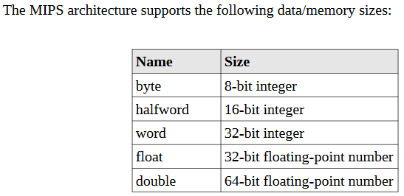
Data Types/Sizes
This architecture supports data storage sizes of:
byte,
halfword (sometimes referred half), or
word sizes.
Floating-point must be of either word (32-bit) size or double word (64-bit) size.
Character data is typically a byte and a string is a series of sequential bytes.
In addition, an arbitrary number of bytes can be defined with the ".space" directive.

Slide 9
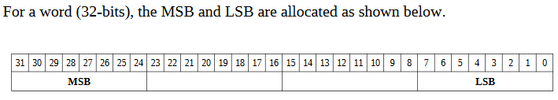
Memory
Memory can be viewed as a series of bytes, one after another.
Memory is byte addressable(each memory address holds one byte of information).
To store a word, four bytes are required which use four memory addresses.
The Least Significant Byte (LSB) is stored in the lowest memory address.
The Most Significant Byte (MSB) is stored in the highest memory location.

Slide 10
More about MIPS Memory Organization
Not all architectures require this
8 bits
32 bits
0x00000000
0x00000000
0
1
2
3
0x00000001
0x00000004
0x00000002
0x00000008
0x00000003
0x0000000C
*Word sizes vary in other architectures
Two views of memory:
2³² bytes with addresses 0, 1, 2, …, 2³²-1
2³⁰ 4-byte words* with addresses 0, 4, 8, …, 2³²-4
Both views use byte addresses
Word address must be multiple of 4 (aligned)

Slide 11
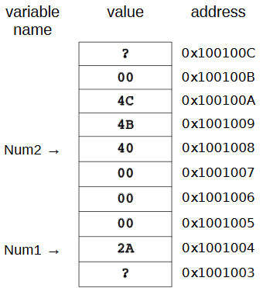
Memory
For example, assuming the following declarations:
num1: .word 42
num2: .word 5000000
Since 42₁₀ in hex, word size, is 0x0000002A and 5,000,000₁₀ in hex, word size, is 0x004C4B40.
For a little-endian architecture, the memory map is shown in Figure:

Slide 12
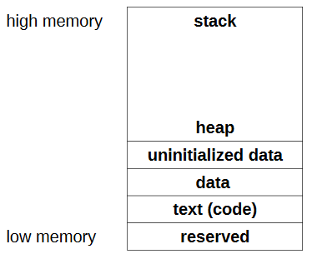
Memory Layout
The general memory layout for a program is as shown:
The reserved section is not available to user programs.
The text (or code) section is where the machine language (i.e., the 1's and 0's that represent the code) is stored.
The data section is where the initialized data is stored.
This include declared variables that have been provided an initial value at assemble time.
The uninitialized data section is where declared variables that have not been provided an initial value are stored.
If accessed before being set, the value will not be meaningful.
The heap is where dynamically allocated data will be stored (if requested).
The stack starts in high memory and grows downward.

Slide 13
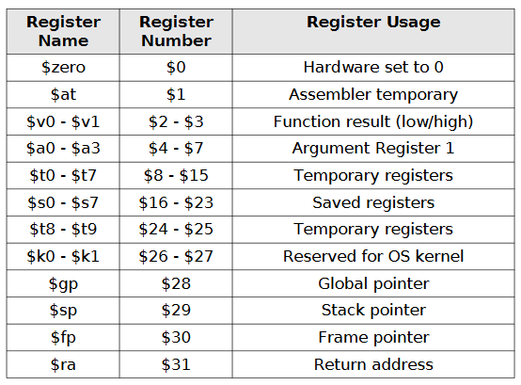
CPU Registers
A CPU register is a temporary storage or working location built into the CPU itself (separate form memory).
Computations are typically performed by the CPU using registers.
The MIPS has 32, 32-bit integer registers($0 through $31) and 32, 32-bit floating-point registers($f0 through $f31).
The MIPS64 operations work on 64-bit integers and 32- or 64-bit floating point.
Some of the integer registers are used for special purposes.
For example, $29 is dedicated for use as the stack pointer register, referred to as $sp.
.

Slide 14
MIPS Registers and Usage
Each register can be referred to by number or name.

Slide 15
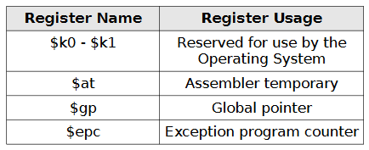
Reserved Registers
The following reserved registers should not be used in user programs.
The $k0 and $k1 registers are reserved for use by the operating system and should not be used in user programs.
The $at register is used by the assembler and should not be used in user programs.
The $gp register is used to point global data (as needed) and should not be used in user programs.

Slide 16
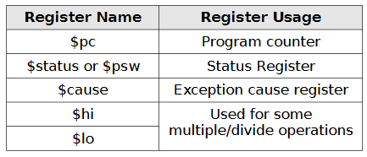
Miscellaneous Registers
In addition to the previously listed registers, there are some miscellaneous registers which are listed in the table:
The $pc or program counter register points to the next instruction to be executed and is automatically updated by the CPU after instruction are executed.
The $status or status register, also called $psw, is the processor status register and is updated after each instruction by the CPU.
The $cause or exception cause register is used by the CPU in the event of an exception or unexpected interruption in program control flow.
Examples of exceptions include division by 0, attempting to access an illegal memory address, or attempting to execute an invalid instruction (e.g., trying to execute a data item instead of code).
The $hi and $lo registers are used by some specialized multiply and divide instructions.
For example, a multiple of two 32-bit values can generate a 64-bit result, which is stored in $hi and $lo (32-bits each or a total of 64-bits).

Slide 17
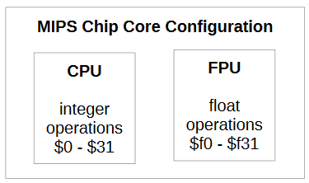
CPU / FPU Core Configuration
The following diagram shows a basic configuration of the MIPS processor internal architecture.
The FPU (floating-point unit) is also referred to as the
FPU co-processor.
FPU is specially designed to carry out operations on floating point numbers.
Typical operations are addition, subtraction, multiplication, division, square root, and bit shifting.

Slide 18
Assembler Directives
An assembler directive is a message to the assembler, that tells the assembler something it needs to know in order to carry out the assembly process.
Assembler directives are not executable statements.
Directives are required for data declarations and to define the start and end of procedures. Assembler directives start with a “.”.
For example, “.data” or “.text”.
Directives are also used to declare and define data.

Slide 19
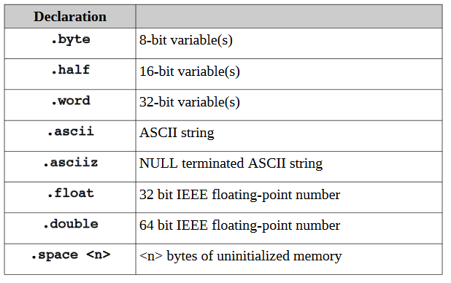
Data Declarations
The supported data types are as follows:
The data must be declared in the “.data" section.
All variables and constants are placed in this section.
Variable definitions must include the name, the data type, and the initial value for the variable.
In the definition, the variable name must be terminated with a ":".
The data type must be preceded with a "." (period). The general format is:
<variableName>: .<dataType> <initialValue>
wVar1: .word 500000
wVar2: .word -100000
hVar1: .half 5000
hVar2: .half -3000

Slide 20
String Data Declarations
Strings are a series of contiguously defined byte-sized characters, typically terminated with a NULL byte (0x00).
Strings are defined with .ascii or .asciiz directives.
message: .asciiz "Hello World\n"
Define a string with multiple lines, the NULL termination would only be required on the final or last line.
For example:
message: .ascii "Line 1: Goodbye World\n"
.ascii "Line 2: So, long and thanks "
.ascii "for all the fish.\n"
.asciiz "Line 3: Game Over.\n“

Slide 21
Floating-Point Data Declarations
Floating-point values are defined with the .float (32-bit) or .double (64-bit) directives.
The IEEE floating-point format is used for the internal representation of floating-point
values.
pi: .float 3.14159
tao: .double 6.28318

Slide 22
Program Code
The code must be preceded by the “ .text " directive.
Naming a "main" procedure:
The ".globl name" and ".ent name" directives are required to define the name of the initial or main procedure.
The main procedure (as all procedures) should be terminated with the ".end <name>" directive.
# Text/code section
.text
.globl main
main:
…
…
.end main

Slide 23
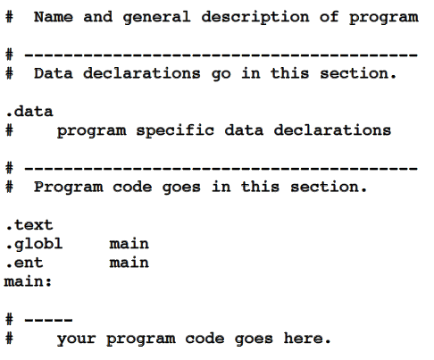
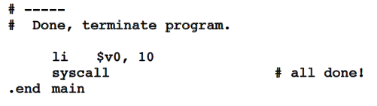
Labels
Labels are code locations,
typically used as function/procedure name or as the target of a jump.
Program Template

Slide 24
Pseudo-Instructions vs Bare-Instructions
The MIPS instruction set is very small, so to do more complicated tasks we need to employ assembler macros called pseudoinstructions.
A pseudo-instruction is an instruction that the assembler will recognize but then
convert into one or more bare-instructions.
In MIPS architecture, the assembly language includes a number of pseudo-instructions, for example, blt, bgt, ble, neg, not, bge, li, la, move etc.
blt $8, $9, label
# A branch if less than pseudoinstruction translates to the following bare-instructions
slt $1, $8, $9
bne $1, $0, label
A bare-instruction is an instruction that is executed by the CPU.
li $8, 0x3BF20 # A load immediate value to a register translates to
lui $at, 0x0003
ori $8, $at, 0xBF20

Slide 25
MIPS Instructions
All instructions exactly 32 bits wide
Different formats for different purposes
Similarities in formats ease implementation
6 bits
5 bits
5 bits
5 bits
5 bits
6 bits
op
rs
rt
rd
shamt
funct
R-Format
31
0
6 bits
5 bits
5 bits
16 bits
op
rs
rt
offset
I-Format
31
0
6 bits
26 bits
J-Format
op
address
31
0

Slide 26
Arithmetic & Logical Instructions - Binary Representation
6 bits
5 bits
5 bits
5 bits
5 bits
6 bits
op
rs
rt
rd
shamt
funct
31
0
Used for arithmetic, logical, shift instructions
op: Basic operation of the instruction (opcode)
rs: first register source operand
rt: second register source operand
rd: register destination operand
shamt: shift amount (more about this later)
funct: function - specific type of operation
Also called “R-Format” or “R-Type” Instructions

Slide 27
Data Transfer Instructions - Binary Representation
6 bits
5 bits
5 bits
16 bits
op
rs
rt
offset
Used for load, store instructions
op: Basic operation of the instruction (opcode)
rs: first register source operand
rt: second register source operand
offset: 16-bit signed address offset (-32,768 to +32,767)
Also called “I-Format” or “I-Type” instructions
Address

Slide 28
MIPS Instructions
All instructions exactly 32 bits wide
Different formats for different purposes
Similarities in formats ease implementation
6 bits
5 bits
5 bits
5 bits
5 bits
6 bits
op
rs
rt
rd
shamt
funct
R-Format
31
0
6 bits
5 bits
5 bits
16 bits
op
rs
rt
offset
I-Format
31
0
6 bits
26 bits
J-Format
op
address
31
0

Slide 29
MIPS Instruction Types
Arithmetic & Logical - manipulate data in registers add $s1, $s2, $s3 $s1 = $s2 + $s3 or $s3, $s4, $s5 $s3 = $s4 OR $s5
Data Transfer - move register data to/from memory lw $s1, 100($s2) $s1 = Memory[$s2 + 100] sw $s1, 100($s2) Memory[$s2 + 100] = $s1
Branch - alter program flow beq $s1, $s2, 25 if ($s1==$s1) PC = PC + 4 + 4*25

Slide 30
MIPS Arithmetic & Logical Instructions
Instruction usage (assembly) add dest, src1, src2 dest=src1 + src2 sub dest, src1, src2 dest=src1 - src2 and dest, src1, src2 dest=src1 AND src2
Instruction characteristics
Always 3 operands: destination + 2 sources
Operand order is fixed
Operands are always general purpose registers

Slide 31
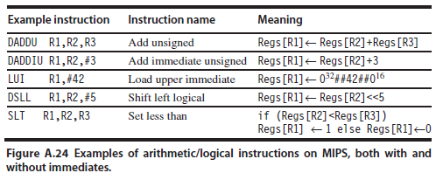

Slide 32
Arithmetic & Logical Instructions - Binary Representation
6 bits
5 bits
5 bits
5 bits
5 bits
6 bits
op
rs
rt
rd
shamt
funct
31
0
Used for arithmetic, logical, shift instructions
op: Basic operation of the instruction (opcode)
rs: first register source operand
rt: second register source operand
rd: register destination operand
shamt: shift amount (more about this later)
funct: function - specific type of operation
Also called “R-Format” or “R-Type” Instructions

Slide 33
Arithmetic & Logical Instructions - Binary Representation Example
Machine language for add $8, $17, $18
See reference card for op, funct values
6 bits
5 bits
5 bits
5 bits
5 bits
6 bits
op
rs
rt
rd
shamt
funct
31
0
0
17
18
8
0
32
Decimal
000000
10001
10010
01000
00000
100000
Binary

Slide 34
Data Transfer Instructions - Binary Representation
6 bits
5 bits
5 bits
16 bits
op
rs
rt
offset
Used for load, store instructions
op: Basic operation of the instruction (opcode)
rs: first register source operand
rt: second register source operand
offset: 16-bit signed address offset (-32,768 to +32,767)
Also called “I-Format” or “I-Type” instructions
Address

Slide 35
I-Format Example
Machine language for lw $9, 1200($8) == lw $t1, 1200($t0)
6 bits
5 bits
5 bits
16 bits
op
rs
rt
offset
31
0
35
8
9
1200
Decimal
100011
01000
01001
0000010010110000
Binary

Slide 36
Example - Loading a Simple Variable
8
R0=0 (constant)
0x00
R1
0x04
+
0x08
R2=0x10
R2=0x10
R3
0x0c
R4
0x10
Variable X
R5
0x14
R5
R5 = 692310
Variable Y
0x18
Variable Z = 692310
Variable Z = 692310
0x1c
R30
R31
Registers
lw R5,8(R2)
Memory

Slide 37
Data Transfer Example - Array Variable
12=0xc
Base Address
R0=0 (constant)
0x00
R1
0x04
+
0x08
R2=0x08
R2=0x08
a[0]
R3
0x0c
a[1]
R4
0x10
a[2]
R5=105
0x14
a[3]=105
R5=105
a[3]
0x18
a[4]
0x1c
R30
R31
Registers
C Program: int a[5];
a[3] = z;
Assembly: sw $5,12($2)
scaled offset
Memory

Slide 38
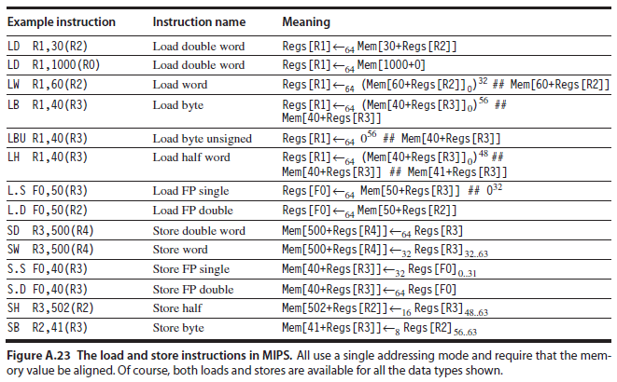

Slide 39
MIPS Conditional Branch Instructions
Conditional branches allow decision making beq R1, R2, LABEL if R1==R2 goto LABEL bne R3, R4, LABEL if R3!=R4 goto LABEL
Example C Code if (i==j) goto L1; f = g + h; L1: f = f - i; Assembly beq $s3, $s4, L1 add $s0, $s1, $s2 L1: sub $s0, $s0, $s3

Slide 40
MIPS Data Transfer Instructions
Transfer data between registers and memory
Instruction format (assembly) lw $dest, offset($addr) load word sw $src, offset($addr) store word
Uses:
Accessing a variable in main memory
Accessing an array element

Slide 41
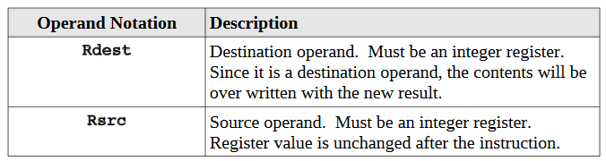
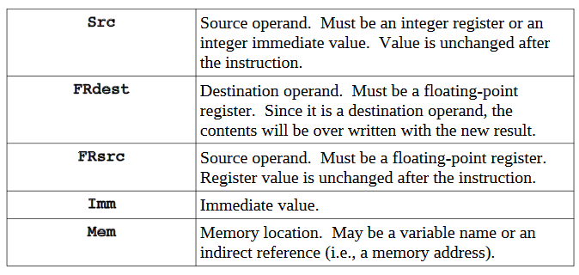
Notational Conventions

Slide 42
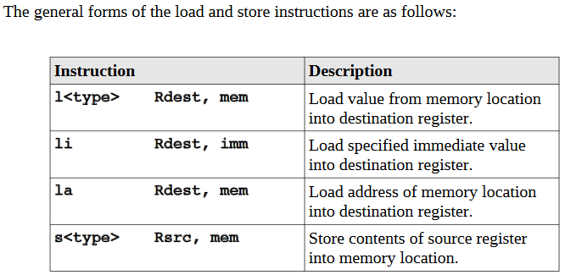
Load and Store
To support the loading of data from memory (e.g., variables or arrays) into registers and storing of data in register back to memory, there are a series of load and store instructions:
The load and store instructions only move data between register and memory.
Data Movement

Slide 43
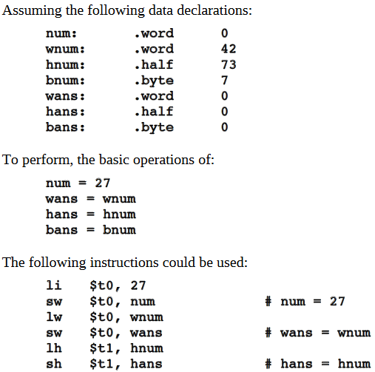
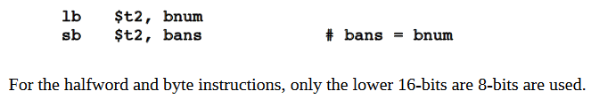

Slide 44
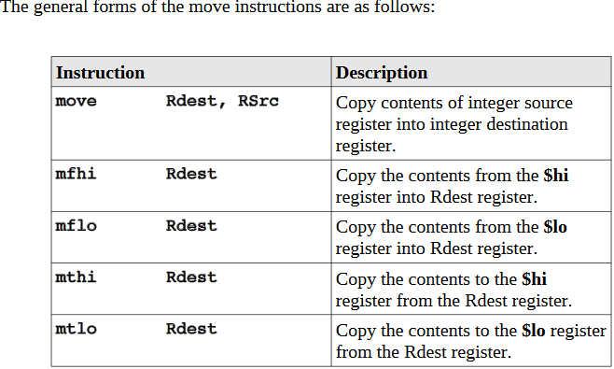
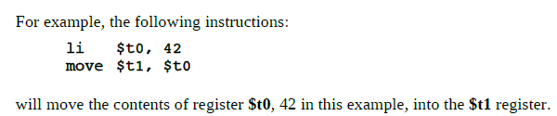
Move Instructions

Slide 45
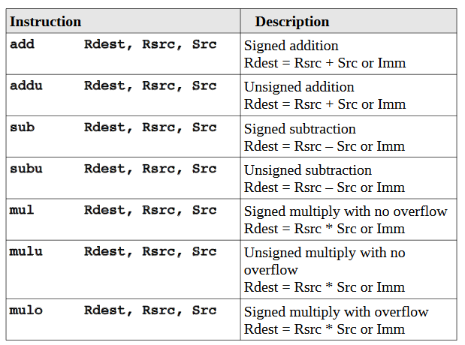
Integer Arithmetic Operations

Slide 46
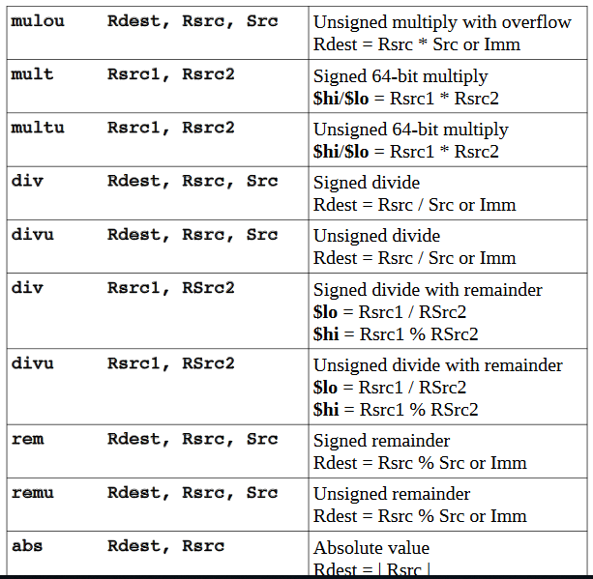


Slide 47
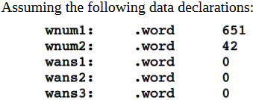
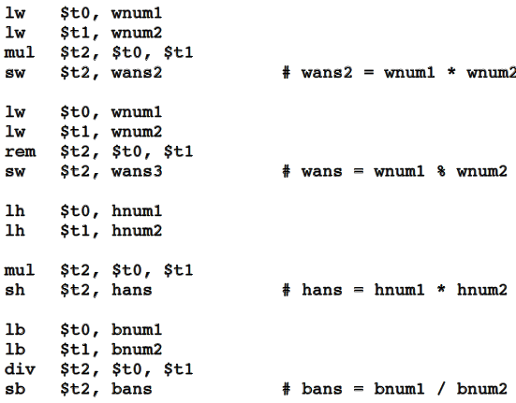
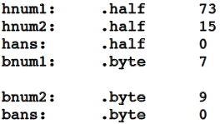
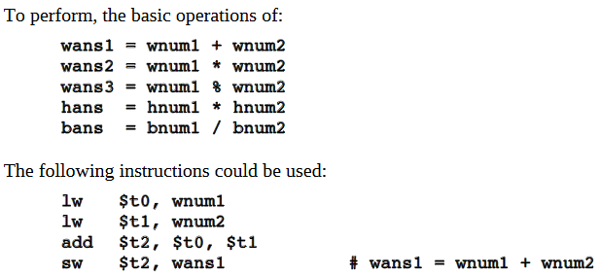

Slide 48

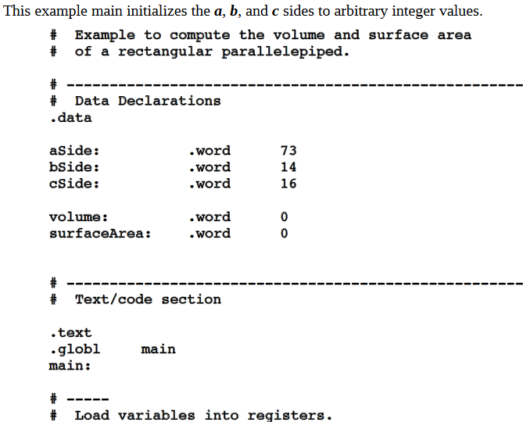
Example Program: Integer Arithmetic
Program to compute the volume and surface area of a rectangular parallelepiped.
The formulas for the volume and surface area are as follows:

Slide 49
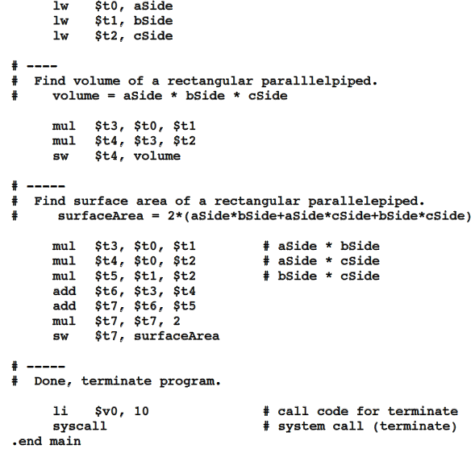

Slide 51

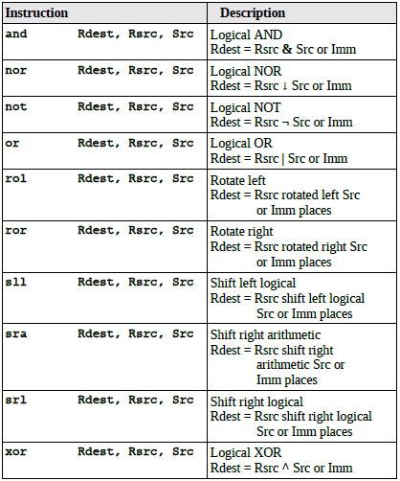

Slide 52
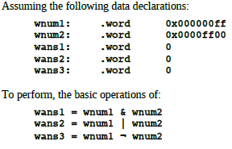
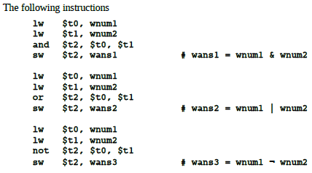

Slide 53
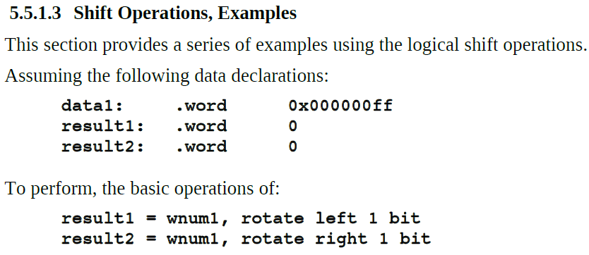
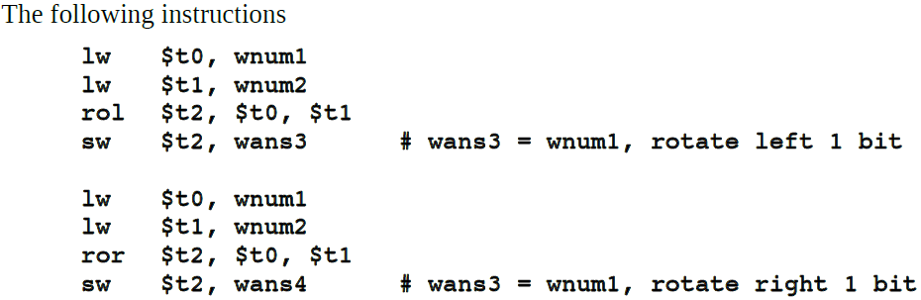

Slide 54
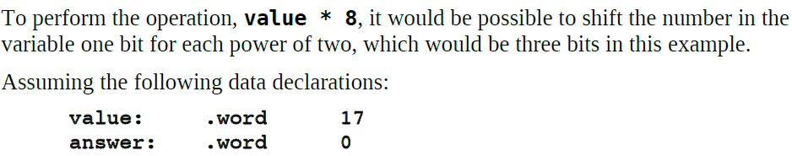
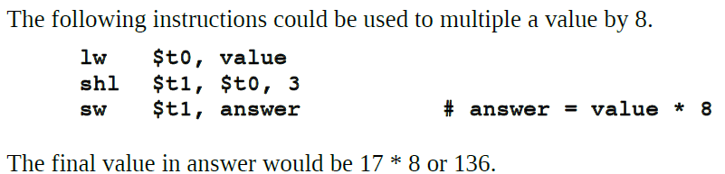

Slide 55
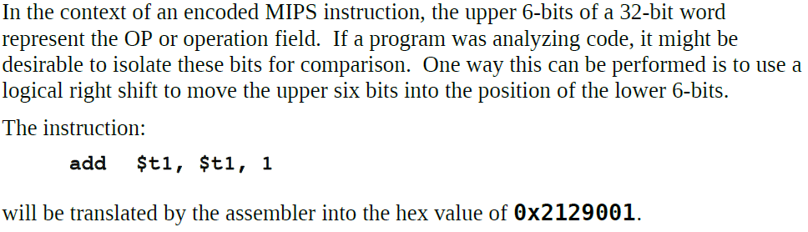
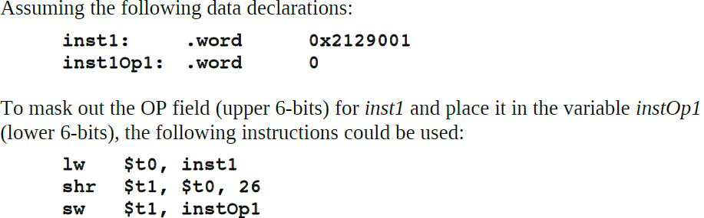

Slide 56
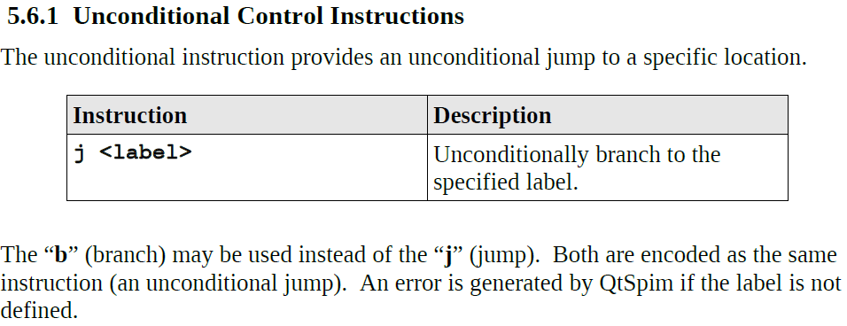

Slide 57
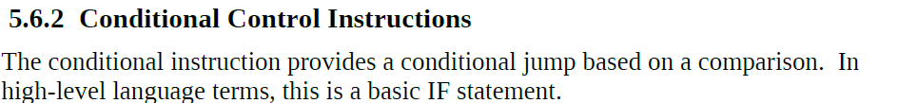
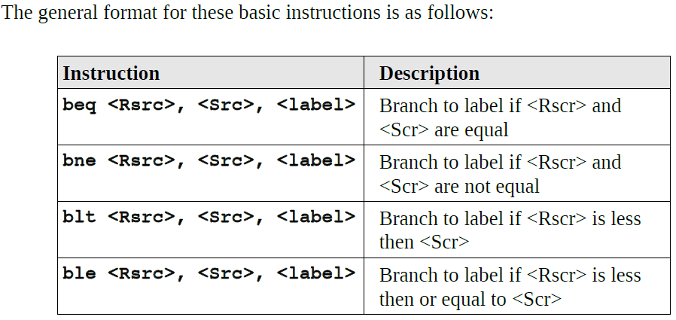
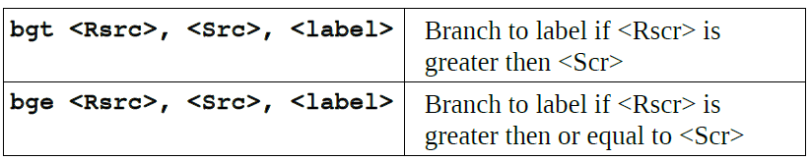

Slide 58
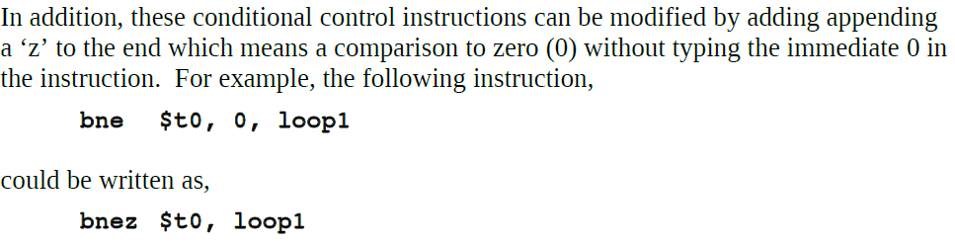

Slide 59
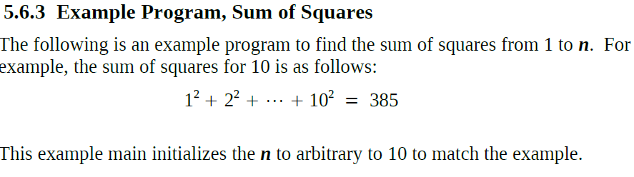
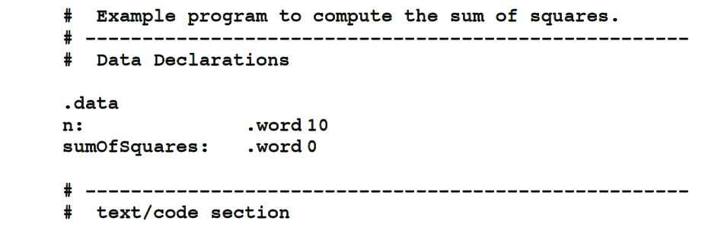

Slide 60
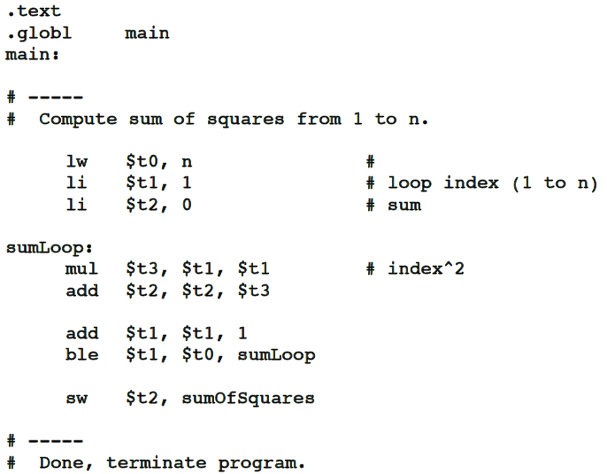


Slide 61
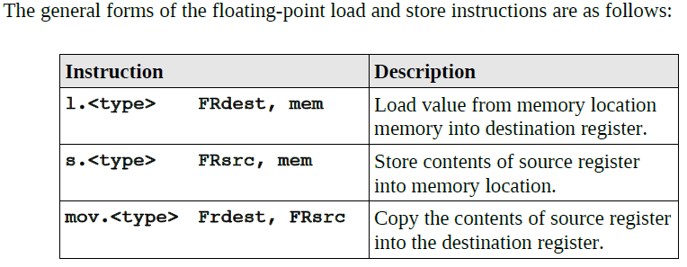
Floating-Point Instructions

Slide 62
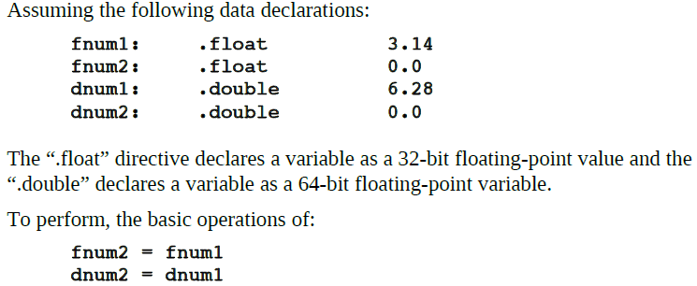
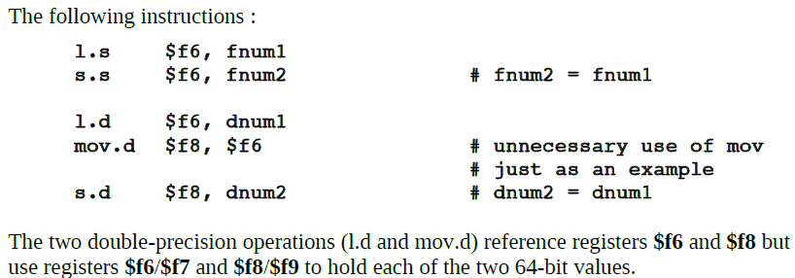

Slide 63
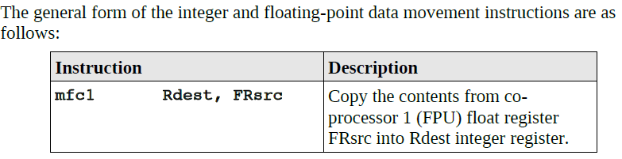

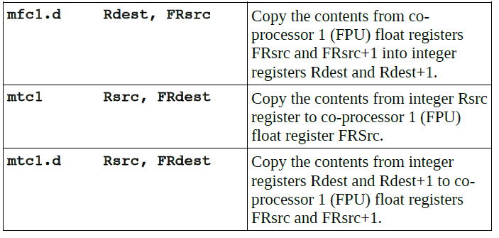
Integer / Floating-Point Register Data Movement

Slide 64


Slide 65


Slide 66


Slide 67


Slide 68

Addressing Modes

Slide 69



6.3 Indirection
The ( )'s are used to denote an indirect memory access. An indirect memory access
means the CPU will read the provided address and then go to that address to access the value located there. For example, to get a value from a list of longs:
la $t0, lst
lw $s1, 4($t0)

